Slide 1
Database Systems: Theory and Programming ER and EER Modeling
Notes:
Replace this with your course title and your name/contact details.

Slide 2
ER Model Concepts

Slide 3
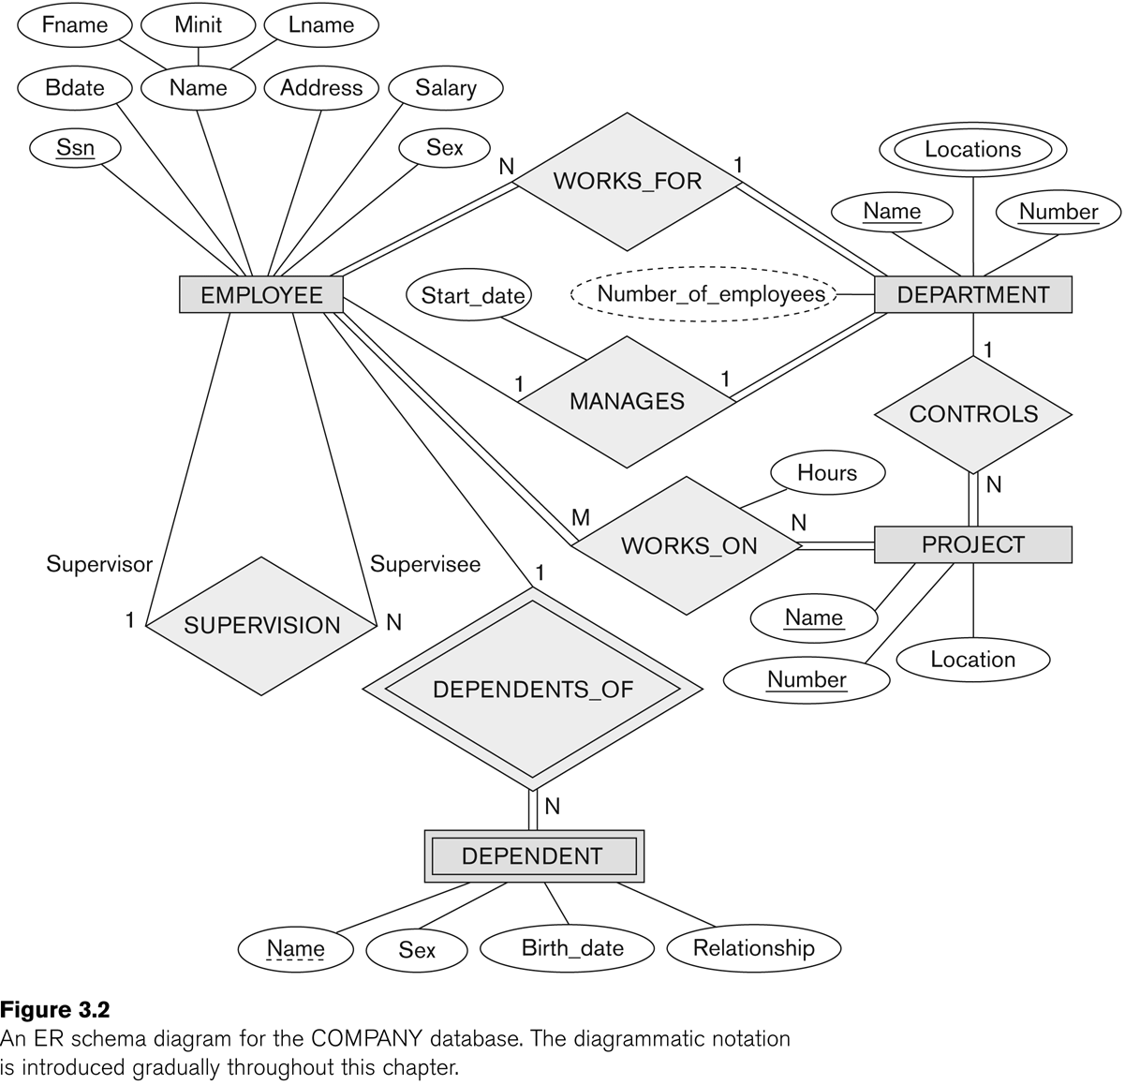
This is the FINAL ER diagram for EMPLOYEE.
We will build up to it gradually.

Slide 4

ER Model Concepts: Entities and Entity Types
see page
64
Entity is a basic concept for the ER model.
Entities are specific things or objects in the mini-world that are represented in the database e.g.,
the entity John Smith which belongs to entity type EMPLOYEE
the entity Research which belongs to the entity type DEPARTMENT,
the entity ProductX which belongs to the entity type PROJECT

Slide 5
ER Model Concepts: Attributes
Attributes are properties used to describe an entity.
For example an EMPLOYEE entity may have the attributes Name, SSN, Address, Sex, BirthDate
A specific entity will have a value for each of its attributes, e.g., an employee whose
Name='John Smith',
SSN='123456789',
Address ='731, Fondren, Houston, TX',
Sex='M',
BirthDate='09-JAN-55‘
Each attribute has a value set (or data type) associated with it – e.g. integer, string, date, enumerated type, …

Slide 6
Types of Attributes (1)
Simple
Each entity has a single atomic value for the attribute. For example, SSN or Sex.
Composite
The attribute may be composed of several components. For example:
Address(Apt#, House#, Street, City, State, ZipCode, Country), or
Name(FirstName, MiddleName, LastName).
May form a hierarchy where some components are themselves composite.
Multi-valued
An entity may have multiple values for that attribute, e.g., a DEPARTMENT may have multiple Locations.

Slide 7
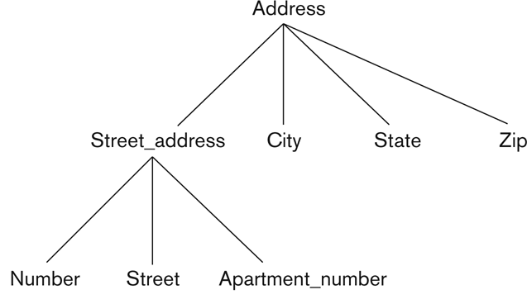
Types of Attributes (2)
In general, composite and multi-valued attributes may be nested arbitrarily to any number of levels, although this is rare.
For example, PreviousDegrees of a STUDENT is a composite multi-valued attribute denoted by {PreviousDegrees (College, Year, Degree, Field)}
Multiple PreviousDegrees values can exist
Each has four subcomponent attributes:
College, Year, Degree, Field
Address can be a composite composite attribute

Slide 8
Types of Attributes (3)
Stored vs Derived Attributes
e.g., Age and Birth_date
Attributes which are allowed to have no value
e.g., Apartment_number
When no value is stored, a special value called NULL is created
NULL could mean either:
Attribute value is not known
Attribute value is not applicable
Sometimes it is difficult to figure out the meaning of NULL

Slide 9
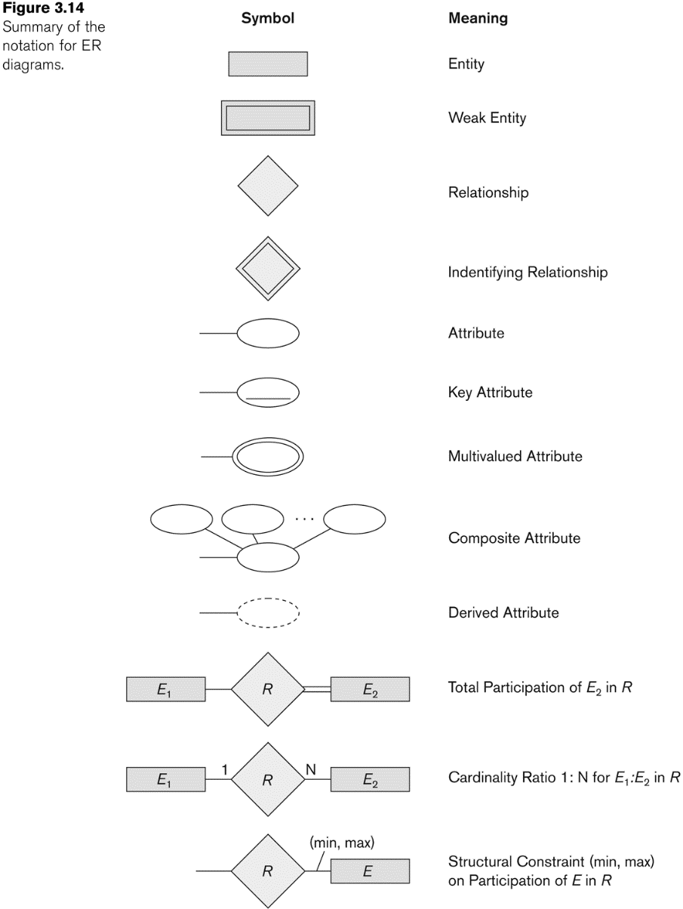
Notation for ER diagrams

Slide 10
Refining the COMPANY database schema by introducing relationships
By examining the requirements, six binary (degree 2) relationship types are identified
WORKS_FOR (between EMPLOYEE, DEPARTMENT)
MANAGES (also between EMPLOYEE, DEPARTMENT)
CONTROLS (between DEPARTMENT, PROJECT)
WORKS_ON (between EMPLOYEE, PROJECT)
SUPERVISION (between EMPLOYEE (as subordinate), EMPLOYEE (as supervisor))
DEPENDENTS_OF (between EMPLOYEE, DEPENDENT)

Slide 11
Discussion on Relationship Types
Some attributes from the initial entity types are refined into relationships:
Manager of DEPARTMENT -> MANAGES
Works_on of EMPLOYEE -> WORKS_ON
Department of EMPLOYEE -> WORKS_FOR
etc
In general, more than one relationship type can exist between the same participating entity types
MANAGES and WORKS_FOR are distinct relationship types between EMPLOYEE and DEPARTMENT
Between EMPLOYEE and DEPARTMENT there are two different relationship instances with two different meanings.

Slide 12
Constraints on Relationships
see page
76-77
Constraints on Relationship Types
(Also known as ratio constraints)
Cardinality Ratio (specifies maximum participation)
One-to-one (1:1)
One-to-many (1:N) or Many-to-one (N:1)
Many-to-many (N:M)
Existence Dependency Constraint (specifies minimum participation) (also called participation constraint)
zero (optional participation, not existence-dependent)
one or more (mandatory participation, existence-dependent)

Slide 13
Recursive Relationship Type
A relationship type between the same participating entity type in distinct roles
Also called a self-referencing relationship type.
Example: the SUPERVISION relationship
EMPLOYEE participates twice in two distinct roles:
supervisor (or boss) role
supervisee (or subordinate) role
Each relationship instance relates two distinct EMPLOYEE entities:
One employee in supervisor role
One employee in supervisee role

Slide 14
Recursive Relationship Type is: SUPERVISION (participation role names are shown)

Slide 15
Weak Entity Types
see page
79
An entity that does not have a key attribute and that is identification-dependent on another entity type.
A weak entity must participate in an identifying relationship type with an owner or identifying entity type
Entities are identified by the combination of:
A partial key of the weak entity type
The particular entity they are related to in the identifying relationship type
Example:
A DEPENDENT entity is identified by the dependent’s first name, and the specific EMPLOYEE with whom the dependent is related
Name of DEPENDENT is the partial key
DEPENDENT is a weak entity type
EMPLOYEE is its identifying entity type via the identifying relationship type DEPENDENT_OF

Slide 16
Attributes of Relationship types
A relationship type can have attributes:
For example, HoursPerWeek of WORKS_ON
Its value for each relationship instance describes the number of hours per week that an EMPLOYEE works on a PROJECT.
A value of HoursPerWeek depends on a particular (employee, project) combination
Most relationship attributes are used with N:M relationships
In 1:N relationships, they can be transferred to the entity type on the N-side of the relationship

Slide 17
Example Attribute of a Relationship Type: Hours of WORKS_ON
Not only can Entities have attributes… …so can Relationships
Also note double lines around the weak entity DEPENDENT and the identifying relationship DEPENDENTS_OF.
An Identifying Relationship is a relationship between a strong and a weak entity type, where the key of the strong entity type is required to uniquely identify instances of the weak entity type.
Double lines between an entity and a relationship indicate total participation

Slide 18
ER Diagrams: Notation

Slide 19
Notation for Constraints on Relationships
Cardinality ratio (of a binary relationship): 1:1, 1:N, N:1, or N:M
Shown by placing appropriate numbers on the relationship edges.
Participation constraint (on each participating entity type): total (called existence dependency) or partial.
Total shown by double line, partial by single line.
NOTE: These are easy to specify for Binary Relationship Types.

Slide 20
Alternative (min, max) notation for relationship structural constraints:
Specified on each participation of an entity type E in a relationship type R
Specifies that each entity e in E participates in at least min and at most max relationship instances in R
Default (no constraint): min=0, max=n (signifying no limit)
Must have min≤max, min≥0, max ≥1
Derived from the knowledge of mini-world constraints
Examples:
A department has exactly one manager and an employee can manage at most one department.
Specify (0,1) for participation of EMPLOYEE in MANAGES
Specify (1,1) for participation of DEPARTMENT in MANAGES
An employee can work for exactly one department but a department can have any number of employees.
Specify (1,1) for participation of EMPLOYEE in WORKS_FOR
Specify (0,n) for participation of DEPARTMENT in WORKS_FOR

Slide 21

An Animated Example is Coming Up Next
WARNING: Constraint notation convention is opposite Min-Max (min, max) notation as you will see on the next slide.
Don't get confused.

Slide 22
WORKS FOR
EMPLOYEE
N
1
DEPARTMENT
Cardinality Notation An employee works for only one department and every employee fully participates in this relationship
A department has many employees and every department fully participates in this relationship
WORKS FOR
EMPLOYEE
(1,1)
(4,N)
DEPARTMENT
(min, max) Notation An employee works for at least one and at most one (hence "one and only one") departments
A department has at least 4 employees, but may have unlimited employees.
MANAGES
EMPLOYEE
1
1
DEPARTMENT
Cardinality Notation An employee can manage only one department; not every employee fully participates in this relationship
A department is managed by only one employee and every department fully participates in this relationship
MANAGES
EMPLOYEE
(0,1)
(1,1)
DEPARTMENT
(min, max) Notation An employee manages at least zero and at most one (hence "may manage only one") departments
A department is managed by at least one and at most one (hence "one and only one") employee

Slide 23
ER Diagram for COMPANY Schema

Slide 24
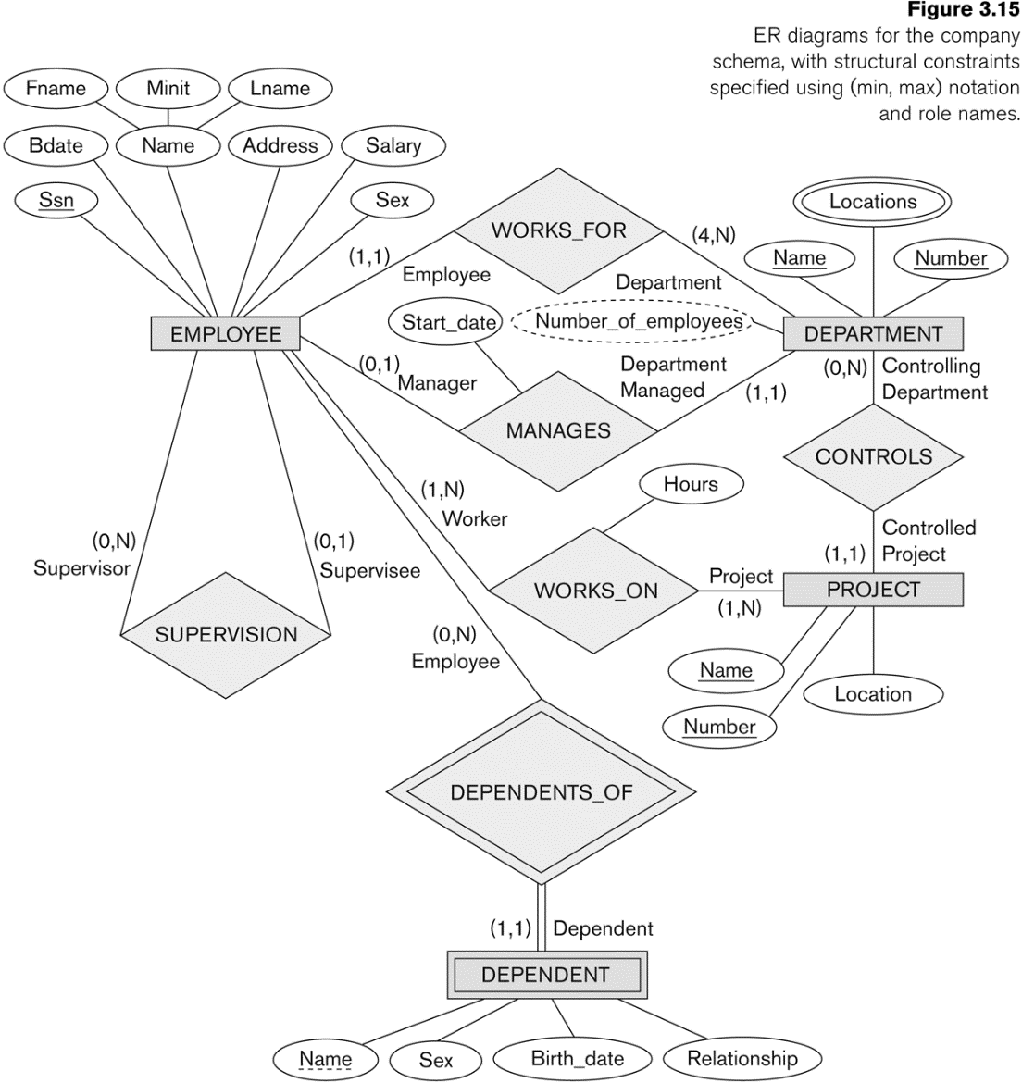
COMPANY ER Schema Diagram using (min, max) notation

Slide 25
Relationships of Higher Degree

Slide 26
Relationships of Higher Degree
Relationship types of degree 2 are called binary
Relationship types of degree 3 are called ternary and of degree n are called n-ary
In general, an n-ary relationship is not equivalent to n binary relationships
Constraints are harder to specify for higher-degree relationships (n > 2) than for binary relationships

Slide 27
Discussion of n-ary relationships (n > 2)
In general, 3 binary relationships can represent different information than a single ternary relationship (see Figure 3.17a and b on next slide)
If needed, the binary and n-ary relationships can all be included in the schema design (see Figure 3.17a and b, where all relationships convey different meanings)
In some cases, a ternary relationship can be represented as a weak entity if the data model allows a weak entity type to have multiple identifying relationships (and hence multiple owner entity types) (see Figure 3.17c)

Slide 28
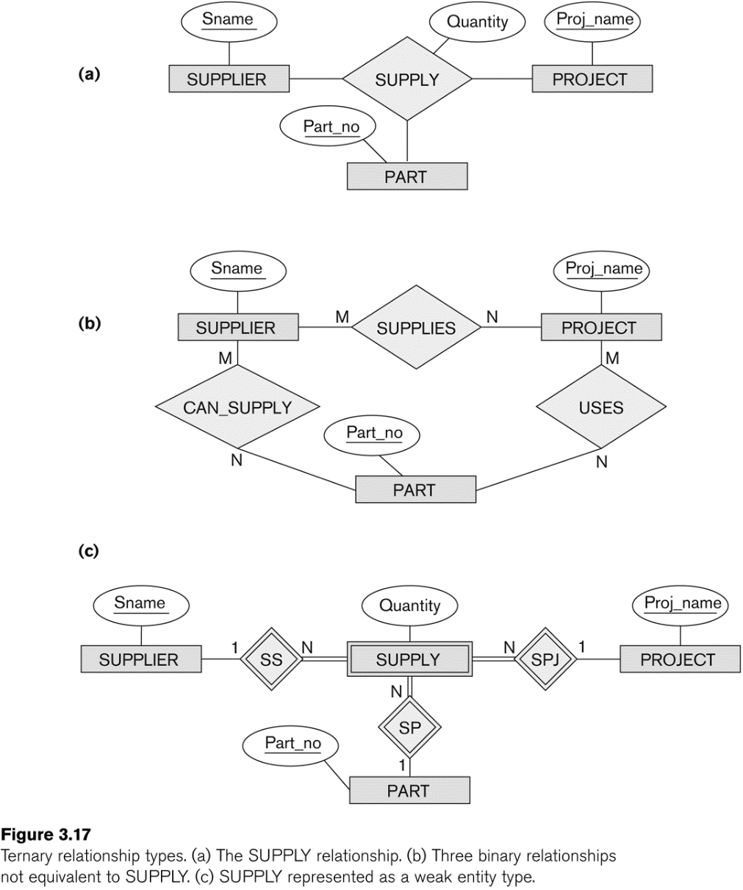
Example of a ternary relationship
Imagine a ternary relationship (SUPPLY) between the Robinson Renovation Project, the furniture supplier KI, and the part Task Chair.
Model (b) does NOT work.
KI can supply Expensive Task Chair as well as Task Chair
The Robinson Renovation Project uses a Task Chair as well as a Smart TV.
The Task Chair was supplied by KI and the Smart TV by supplier Best Buy for the Robinson Renovation Project.
How can these relationships be preserved?
see page
89

Slide 29
Example of a ternary relationship
SUPPLIER
Sname
KI
Best Buy
PROJECT
Proj_name
Robinson Renovation Project
see page
89
Weak Entity Review
An entity that does not have a key attribute and that is identification-dependent on another entity type.
A weak entity must participate in an identifying relationship type with an owner or identifying entity type
PART
Part_no | Part_name
CH-1 | Task Chair
CH-1D | Expensive Task Chair
TV-204c | Smart TV
Model (c) does work.
As a weak entity, SUPPLY does not have a key. (2 TVs & 2 chairs bought.)
Depends on SUPPLIER, PART and PROJECT for meaning
SUPPLY
Quantity
2
2

Slide 30
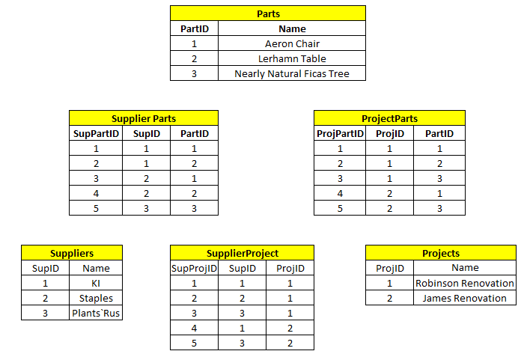
Data Loss
What do we know about the Robinson Renovation Project?
It used KI, Staple and Plants`Rus as Suppliers
It included Aeron Chairs, Lerhamn Tables and Ficas Trees
Q: Who supplied the Ficas Trees for the Robinson project?
A: Plants`Rus
Q: Who supplied the Aeron Chairs for the Robinson project?
A: Can’t tell

Slide 31
Displaying constraints on higher-degree relationships
The (min, max) constraints can be displayed on the edges – however, they do not fully describe the constraints
Displaying a 1, M, or N indicates additional constraints
An M or N indicates no constraint
A 1 indicates that an entity can participate in at most one relationship instance that has a particular combination of the other participating entities
In general, both (min, max) and 1, M, or N are needed to describe fully the constraints
Overall, the constraint specification is difficult and possibly ambiguous when we consider relationships of a degree higher than two.

Slide 32
Another Example: A UNIVERSITY Database
To keep track of the enrollments in classes and student grades, another database is to be designed.
It keeps track of the COLLEGEs, DEPARTMENTs within each college, the COURSEs offered by departments, and SECTIONs of courses, INSTRUCTORs who teach the sections etc.
These entity types and the relationships among these entity types are shown on the next slide in Figure 3.20.

Slide 33
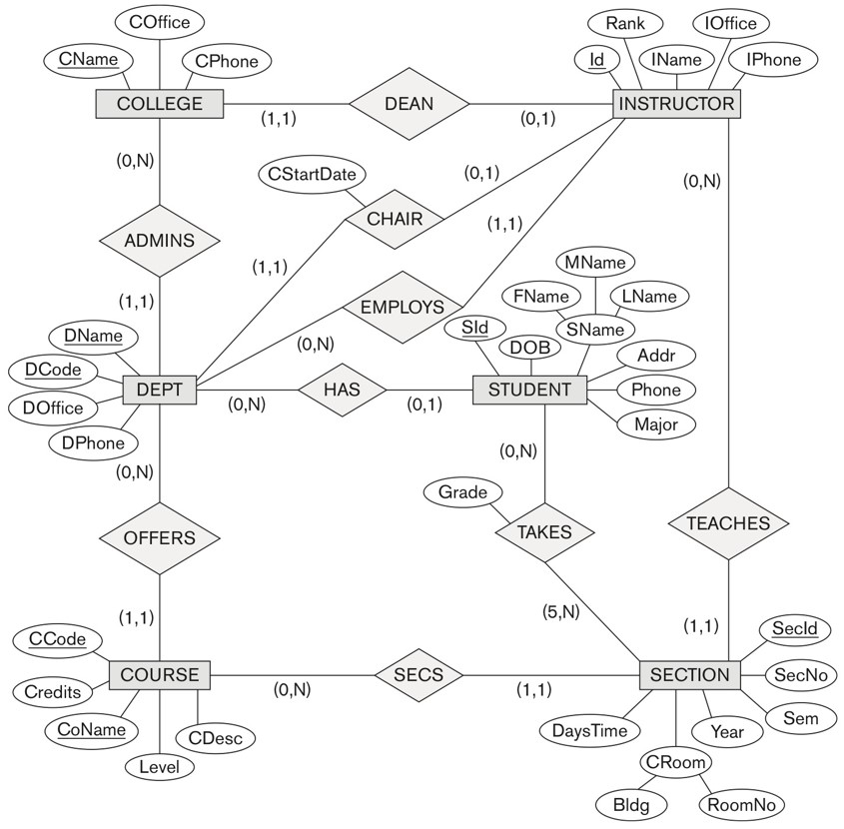
UNIVERSITY database conceptual schema
see page
94
An Instructor can teach a minimum of 0 sections, but has no maximum number of sections.
A section can be taught by one and only one instructor.
A course can have zero or many sections.
What are the other relationship facts modeled here?

Slide 34

Database Systems: Theory and Programming
SECTION 9.1
Relational DB Design Using ER-to-Relational Mapping

Slide 35
Key Steps
see pgs
290-300
ER-to-Relational Mapping Algorithm
Step 1: Mapping of Regular Entity Types
Step 2: Mapping of Weak Entity Types
Step 3: Mapping of Binary 1:1 Relation Types
Step 4: Mapping of Binary 1:N Relationship Types.
Step 5: Mapping of Binary M:N Relationship Types.
Step 6: Mapping of Multivalued attributes.
Step 7: Mapping of N-ary Relationship Types.
Mapping EER Model Constructs to Relations
Step 8: Options for Mapping Specialization or Generalization.
Step 9: Mapping of Union Types (Categories).

Slide 36
GOALS during Mapping
Preserve all information (that includes all attributes)
Maintain the constraints to the extent possible (Relational Model cannot preserve all constraints- e.g., max cardinality ratio such as 1:10 in ER; exhaustive classification into subtypes, e.g., STUDENTS are specialized into Domestic and Foreign)
Minimize null values

Slide 37
ER Mapping: How to Handle Entity Types
Step 1: Mapping of Regular Entity Types.
For each regular (strong) entity type E in the ER schema, create a relation (table) R that includes all the simple attributes of E.
Choose one of the key attributes of E as the primary key for R.
If the chosen key of E is composite, the set of simple attributes that form it will together form the primary key of R.
Step 2: Mapping of Weak Entity Types
For each weak entity type W in the ER schema with owner entity type E, create a relation (table) R & include all simple attributes (or simple components of composite attributes) of W as attributes of R.
Also, include as foreign key attributes of R the primary key attribute(s) of the relation(s) that correspond to the owner entity type(s).
The primary key of R is the combination of the primary key(s) of the owner(s) and the partial key of the weak entity type W, if any.

Slide 38
ER Mapping: How to Handle 1:1 Relationships (1)
Step 3: Mapping of Binary 1:1 Relation Types
For each binary 1:1 relationship type R in the ER schema, identify the relations S and T that correspond to the entity types participating in R.
There are three possible approaches:
Foreign Key (2 table) approach: Choose one of the relations-say S-and include a foreign key in S the primary key of T. It is better to choose an entity type with total participation in R in the role of S.
An EMPLOYEE manages one and only one DEPARTMENT ; A DEPARTMENT is managed by one and only one EMPLOYEE
Giving DEPARTMENT a manager_id field is better than giving EMPLOYEE a DEPARTMENT field
The participation of DEPARTMENT in the MANAGES relationship type is total.

Slide 39
ER Mapping: How to Handle 1:1 Relationships (2)
Step 3: Mapping of Binary 1:1 Relation Types
For each binary 1:1 relationship type R in the ER schema, identify the relations S and T that correspond to the entity types participating in R.
There are three possible approaches:
Merged relation (1 table) option: An alternate mapping of a 1:1 relationship type is possible by merging the two entity types and the relationship into a single relation. This may be appropriate when both participations are total.
Every ROWAN_STUDENT is also a ROWAN_PATIENT (able to see Rowan physicians)
Merging of the medical information with the academic information into a single table might be the best option.
Cross-reference or relationship relation (3 table) option: The third alternative is to set up a third relation R for the purpose of cross-referencing the primary keys of the two relations S and T representing the entity types. A "bridging table" for a 1:1 relationship
Perhaps ROWAN_STUDENT data (PK = BannerID) and ROWAN_PATIENT data (PK = PatientNum) are in two separate schemas.
One of the schemas could maintain the link between BannerID and PatientNum

Slide 40
ER Mapping: How to Handle 1:N Relationships
Step 4: Mapping of Binary 1:N Relationship Types.
There are two possible approaches:
The foreign key approach: For each regular binary 1:N relationship type R, identify the relation S that represent the participating entity type at the N-side of the relationship type.
Include as foreign key in S the primary key of the relation T that represents the other entity type participating in R.
Include any simple attributes of the 1:N relation type as attributes of S.
An EMPLOYEE works for one and only one DEPARTMENT ; A DEPARTMENT has working for it many EMPLOYEEs (A, EMPLOYEE is the "N-side")
The EMPLOYEE table could hold the dept_number foreign key and the date_joined attribute of the relationship. (B)
Cross-reference or relationship relation (3 table) option: The second alternative is to set up a third relation R for the purpose of cross-referencing the primary keys of the two relations S and T representing the entity types. A "bridging table" for a 1:N relationship. Why?
Hedge your bets that the relationship could move to N:M in the future
Maybe the foreign key column would have a lot of nulls, as the relationship is rare.

Slide 41
ER Mapping: How to Handle N:M Relationships
Step 5: Mapping of Binary M:N Relationship Types.
For each regular binary M:N relationship type R, create a new relation (table) S to represent R. This is a relationship relation. "the bridging table"
Include as foreign key attributes in S the primary keys of the relations that represent the participating entity types; their combination will form the primary key of S. (or add a meaningless simple primary key.)
Also include any simple attributes of the M:N relationship type (or simple components of composite attributes) as attributes of S.

Slide 42
ER Mapping: How to Handle Multivalued Attributes
Step 6: Mapping of Multivalued attributes.
For each multivalued attribute A, create a new relation (table) R.
This relation (table) R will include an attribute corresponding to A, plus the primary key attribute K -as a foreign key in R- of the relation that represents the entity type of relationship type that has A as an attribute.
The primary key of R is the combination of A and K. If the multivalued attribute is composite, we include its simple components.
Example: The relation DEPT_LOCATIONS is created.
The attribute DLOCATION represents the multivalued attribute LOCATIONS of DEPARTMENT, while DNUMBER - as foreign key - represents the primary key of the DEPARTMENT relation.
The primary key of R is the combination of {DNUMBER, DLOCATION}. (or add a meaningless simple primary key.)

Slide 43
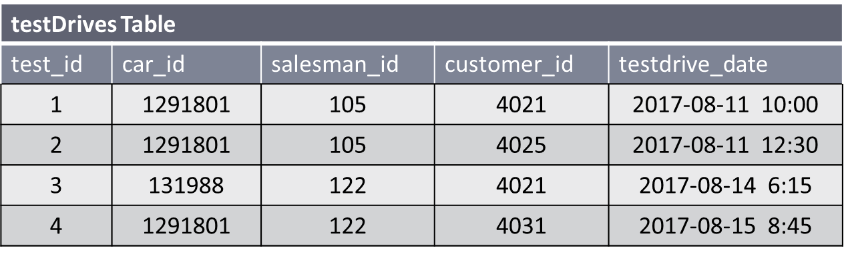
ER Mapping N-ary Relationships
Step 7: Mapping of N-ary Relationship Types.
For each n-ary relationship type R, where n>2, create a new relationship S to represent R.
Include as foreign key attributes in S the primary keys of the relations that represent the participating entity types.
Also include any simple attributes of the n-ary relationship type (or simple components of composite attributes) as attributes of S.
Consider the Ternary relationship between a CAR, a SALESPERSON, and a CUSTOMER
Three foreign keys

Slide 44
Database Systems: Theory and Programming
Chapter 4
Enhanced Entity-Relationship (EER) Modeling

Slide 45
Subclasses and Superclasses

Slide 46
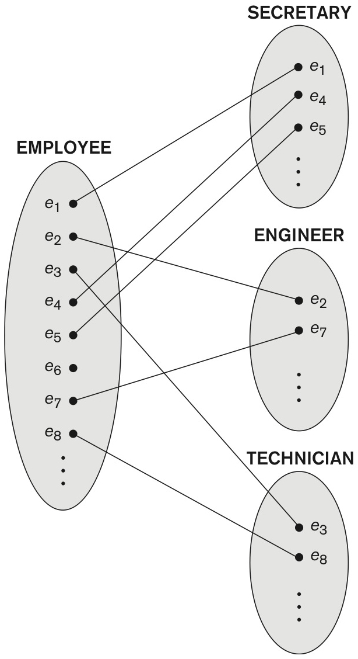
Subclasses and Superclasses (1)
An entity type may have additional meaningful subgroupings of its entities
Example: EMPLOYEE may be further grouped into:
SECRETARY, ENGINEER, TECHNICIAN, …
Based on the EMPLOYEE’s Job
MANAGER
EMPLOYEEs who are managers (the role they play)
SALARIED_EMPLOYEE, HOURLY_EMPLOYEE
Based on the EMPLOYEE’s method of pay
EER diagrams extend ER diagrams to represent these additional subgroupings, called subclasses or subtypes

Slide 47
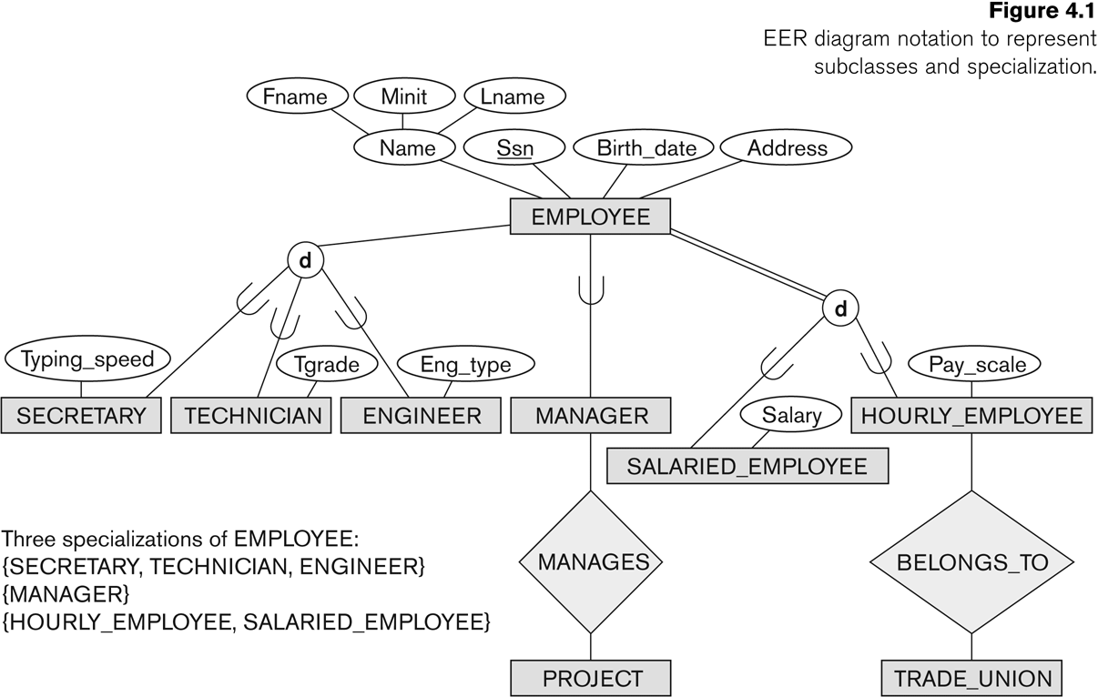
Subclasses and Superclasses
EMPLOYEE fully participates in the disjoint relationship with subclasses HOURLY_EMPLOYEE and SALARIED_EMPLOYEE.
An EMPLOYEE is either one or the other subclass,
As if it were an Abstract superclass…
see page
…but EMPLOYEE does not fully participate with these three roles. Either there are more roles
- or -
some EMPLOYEES are not specialized and it cannot be abstract.
109
disjoint: EMPLOYEE cannot be both,

Slide 48
Subclasses and Superclasses (2)
Each of these subgroupings is a subset of EMPLOYEE entities
Each is called a subclass of EMPLOYEE
EMPLOYEE is the superclass for each of these subclasses
These are called superclass/subclass relationships:
EMPLOYEE/SECRETARY
EMPLOYEE/TECHNICIAN
EMPLOYEE/MANAGER
…
These are also called IS-A relationships
SECRETARY IS-A EMPLOYEE, TECHNICIAN IS-A EMPLOYEE, ….
Note: An entity that is member of a subclass represents the same real-world entity as some member of the superclass:
The subclass member is the same entity in a distinct specific role
An entity cannot exist in the database merely by being a member of a subclass; it must also be a member of the superclass
A member of the superclass can be optionally included as a member of any number of its subclasses

Slide 49
Subclasses and Superclasses (3)
see page
109
A salaried employee who is also an engineer belongs to the two subclasses ENGINEER and SALARIED_EMPLOYEE
A salaried employee who is also an engineering manager belongs to the three subclasses: MANAGER, ENGINEER, and SALARIED_EMPLOYEE
It is not necessary that every entity in a superclass be a member of some subclass

Slide 50
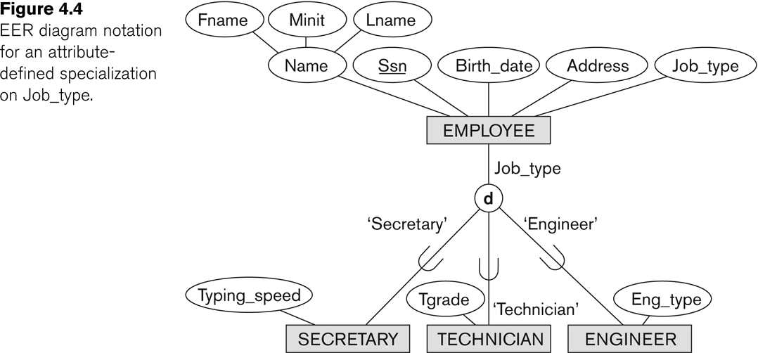
Representing Specialization in EER Diagrams
see page
114

Slide 51
Attribute Inheritance in Superclass / Subclass Relationships
An entity that is member of a subclass inherits
All attributes of the entity as a member of the superclass
All relationships of the entity as a member of the superclass
Example:
In the previous slide, SECRETARY (as well as TECHNICIAN and ENGINEER) inherit the attributes Name, SSN, …, from EMPLOYEE
Every SECRETARY entity will have values for the inherited attributes

Slide 52
Specialization and Generalization

Slide 53
Specialization
Specialization is the process of defining a set of subclasses of a superclass
The set of subclasses is based upon some distinguishing characteristics of the entities in the superclass
Example: {SECRETARY, ENGINEER, TECHNICIAN} is a specialization of EMPLOYEE based upon job type.
Example: MANAGER is a specialization of EMPLOYEE based on the role the employee plays
May have several specializations of the same superclass
Example: Another specialization of EMPLOYEE based on method of pay is {SALARIED_EMPLOYEE, HOURLY_EMPLOYEE}.
Superclass/subclass relationships and specialization can be diagrammatically represented in EER diagrams
Attributes of a subclass are called specific or local attributes.
For example, the attribute TypingSpeed of SECRETARY
The subclass can also participate in specific relationship types.
For example, a relationship BELONGS_TO of HOURLY_EMPLOYEE

Slide 54
Depicting Generalization and Specialization
see page
109

Slide 55
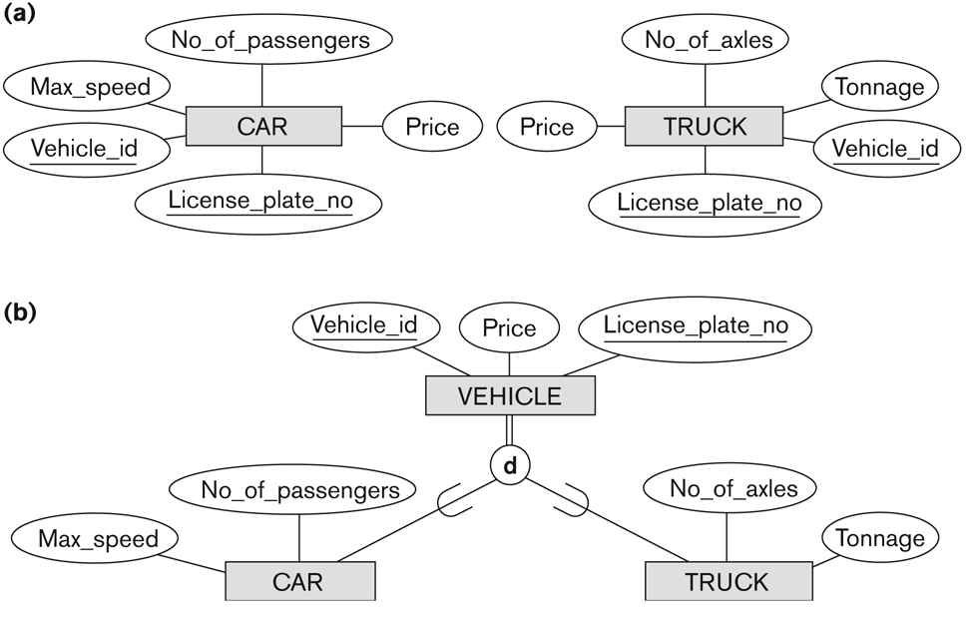
Generalization
see page
112
Generalization is the reverse of the specialization process
Several classes with common features are generalized into a superclass;
original classes become its subclasses
Example: CAR, TRUCK generalized into VEHICLE;
both CAR, TRUCK become subclasses of the superclass VEHICLE.
We can view {CAR, TRUCK} as a specialization of VEHICLE
Alternatively, we can view VEHICLE as a generalization of CAR and TRUCK

Slide 56
Constraints on Specialization and Generalization

Slide 57
More Constraints on Specialization and Generalization
Disjointness Constraint:
Specifies that the subclasses of the specialization must be disjoint:
an entity can be a member of at most one of the subclasses of the specialization
Specified by d in EER diagram
If not disjoint, specialization is overlapping:
that is the same entity may be a member of more than one subclass of the specialization
Specified by o in EER diagram
Completeness (Exhaustiveness) Constraint:
Total specifies that every entity in the superclass must be a member of some subclass in the specialization/generalization
Shown in EER diagrams by a double line
Partial allows an entity not to belong to any of the subclasses
Shown in EER diagrams by a single line

Slide 58
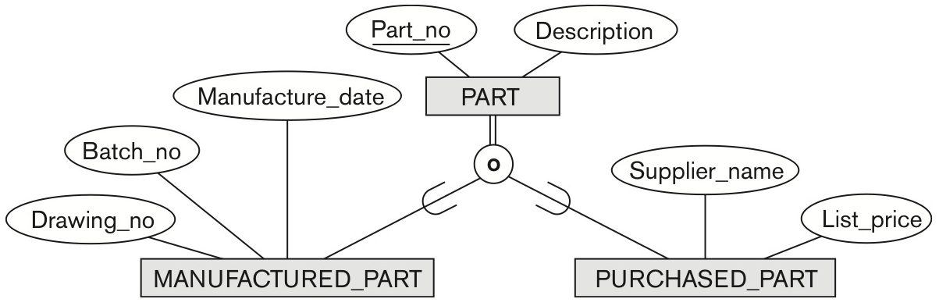
Types of Specialization and Generalization
see page
115
Hence, we have four types of specialization/generalization:
Disjoint, total
Disjoint, partial
Overlapping, total
Overlapping, partial
Note: Generalization usually is total because the superclass is derived from the subclasses.
Overlapping total

Slide 59
Example of disjoint partial Specialization
see page
114

Slide 60
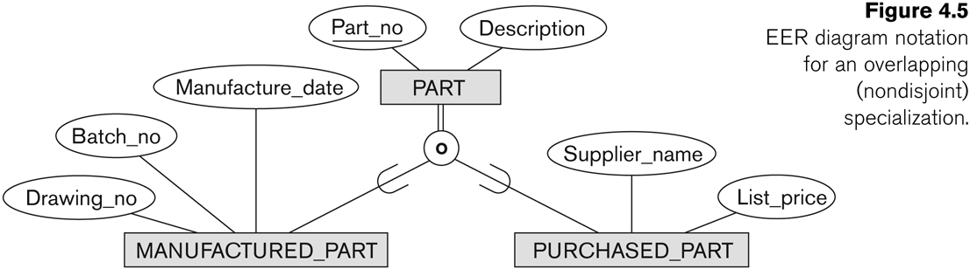
Example of overlapping total Specialization
see page
114

Slide 61
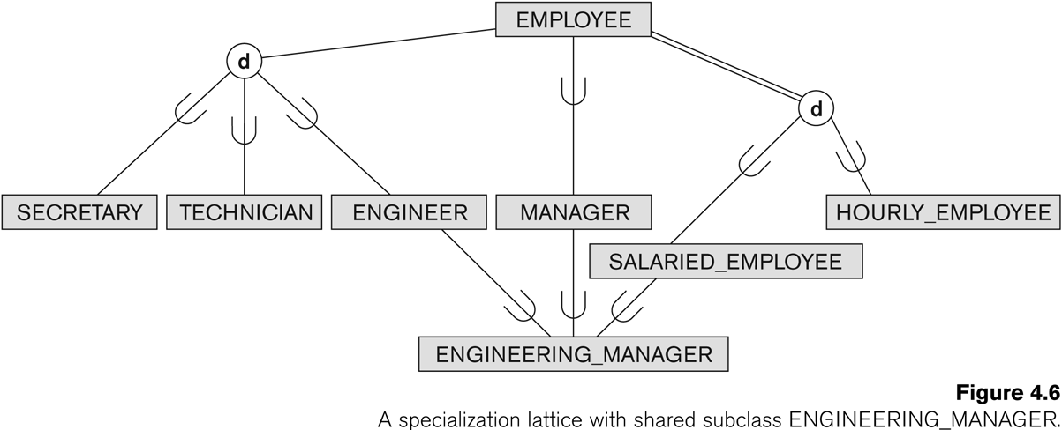
Shared Subclass ENGINEERING_MANAGER
see page
116
Multiple Inheritance

Slide 62
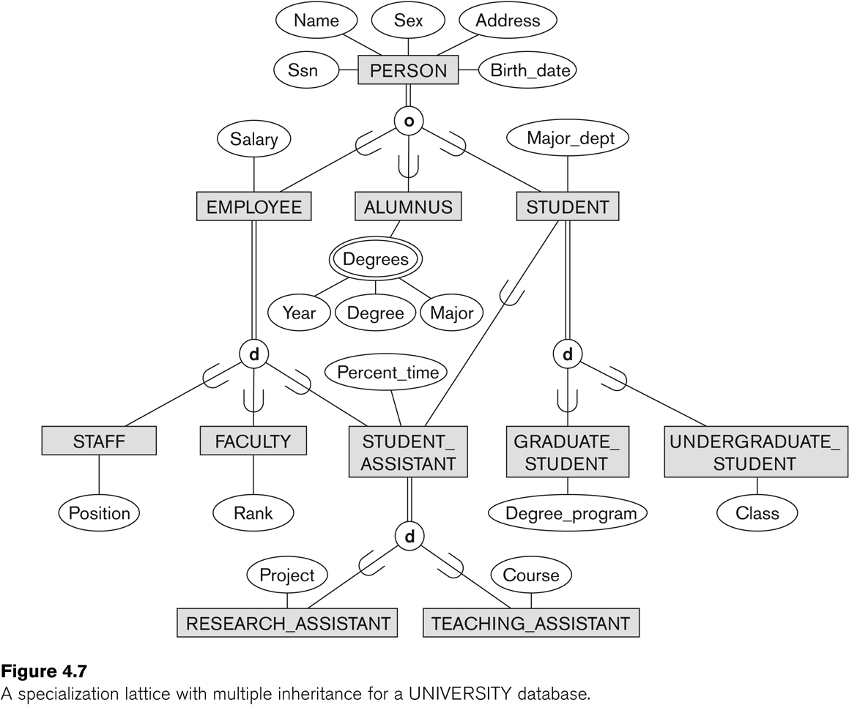
Specialization / Generalization Lattice Example (UNIVERSITY)
see page
117

Slide 63
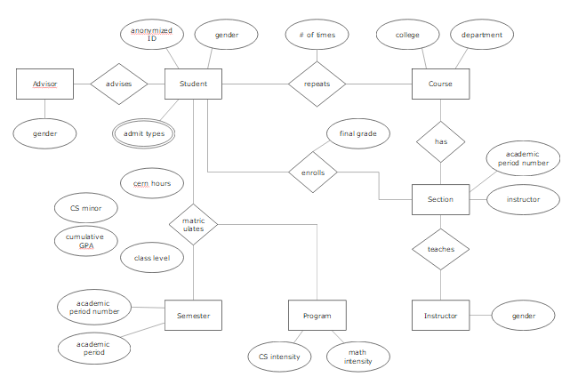

Practice: How would you turn this ER diagram into an EER diagram?
anonym-ized ID
gender
# of times
college
depart-ment
Advisor
advises
Student
repeats
Course
name
gender
admit type
final grade
has
enrolls
academic period number
CERN hours
CS minor?
Section
instructor
matricu-lates
cumula-tive GPA
teaches
class level
academic period number
Semester
Program
Instructor
gender
academic period
CS intensity
math intensity

Slide 64
Categories (UNION types)

Slide 65
Categories (UNION TYPES) (1)
All of the superclass/subclass relationships we have seen thus far have a single superclass
A shared subclass is a subclass in:
more than one distinct superclass/subclass relationships
each relationships has a single superclass
shared subclass leads to multiple inheritance
In some cases, we need to model a single superclass/subclass relationship with more than one superclass
Superclasses can represent different entity types
Such a subclass is called a category or UNION TYPE

Slide 66
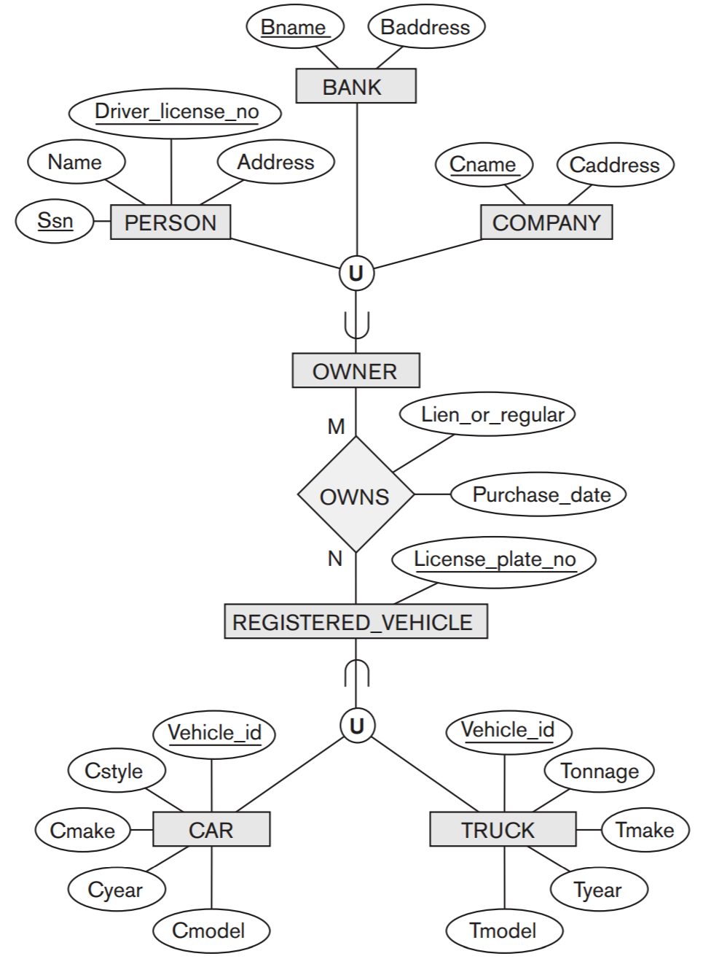
Categories (UNION TYPES) (2)
see page
121
Example: In a database for vehicle registration, a vehicle owner can be a PERSON, a BANK (holding a lien on a vehicle) or a COMPANY.
A category (UNION type) called OWNER is created to represent a subset of the union of the three superclasses COMPANY, BANK, and PERSON
A category member must exist in at least one (typically just one) of its superclasses
Difference from shared subclass, which is a:
subset of the intersection of its superclasses
shared subclass member must exist in all of its superclasses

Slide 67
Attribute and Relationship Inheritance

Slide 68
Database Systems: Theory and Programming
SECTION 9.2
Mapping EER Model Constructs to Relations

Slide 69
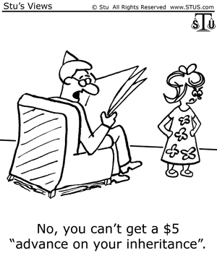
Inheritance
Inheritance is not implemented in relational databases.
So how is an object oriented structure interpreted?
Strategy | Implementation
Single table per class hierarchy (default) | The sum of the attributes of the entire entity hierarchy flattened to a single table.
Joined subclass strategy | Each entity in the hierarchy mapped to its own table.
Table per concrete class strategy | Each concrete entity hierarchy is mapped to its own table

Slide 70
✓ Concept Check: Concrete vs. Abstract Classes
Concrete Class
Will be annotated with @Entity.
Abstract Class
Also known as nonentity; will be used to provide structure only.
CONCRETE CLASS
A class that is designed to create instances.
ABSTRACT CLASS
A class that is not intended for creating instances. Its purpose is to serve as a superclass for other classes.

Slide 71
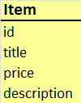
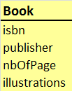
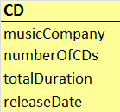
Inheritance Strategies
Note column DTYPE, known as a Discriminator
Table per concrete class
Joined subclass
Root Entity
key inherited by subclasses
Single table per class hierarchy

Slide 72
Comparison
Table per concrete class (option 8B)
Option 8D (variant of Option 8C) not shown
Joined subclass (option 8D)
Single table per class hierarchy
Default
Wasted space, lots of blanks
Not normalized
Leaf node attributes (i.e., BOOK and CD) must be nullable
Joined subclass
Natural, object-oriented layout
All queries to leaf nodes require table joins with root entity
Performance issues
Table per Concrete Class
Denormalized
You can no longer join the tables. (If you want to display ITEMS, BOOKS, and CDs together, need to use the expensive UNION operation.
Single table per class hierarchy (option 8C)

Slide 73
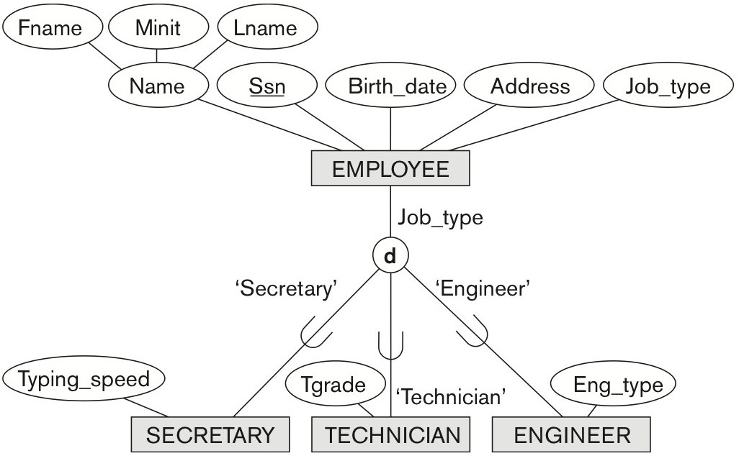
An EER Example of Inheritance
Not full participation as subclasses of Employees. Thus additional jobs, such as CEO and Janitor can exist.

Slide 74
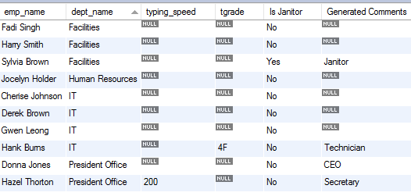
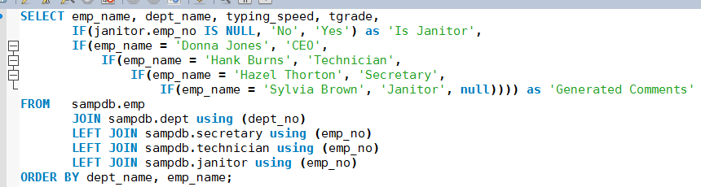
Our Employees

Slide 75
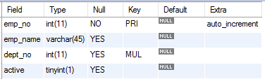



Physical Structure
emp
technician
secretary
janitor
Joined subclass
Joined subclass without DTYPE
Natural, object-oriented layout
All queries to leaf nodes require table joins with root entity
Performance issues
No way to identify CEO

Slide 76
Mapping EER Inheritance
Step 8: Options for Mapping Specialization or Generalization.
Convert each specialization with m subclasses {S1, S2,….,Sm} and generalized superclass C, where the attributes of C are {k,a1,…an} and k is the (primary) key, into relational schemas using one of the four following options:
Option 8A: Multiple relations-Superclass and subclasses
Option 8B: Multiple relations-Subclass relations only
Option 8C: Single relation with one type attribute
Option 8D: Single relation with multiple type attributes

Slide 77
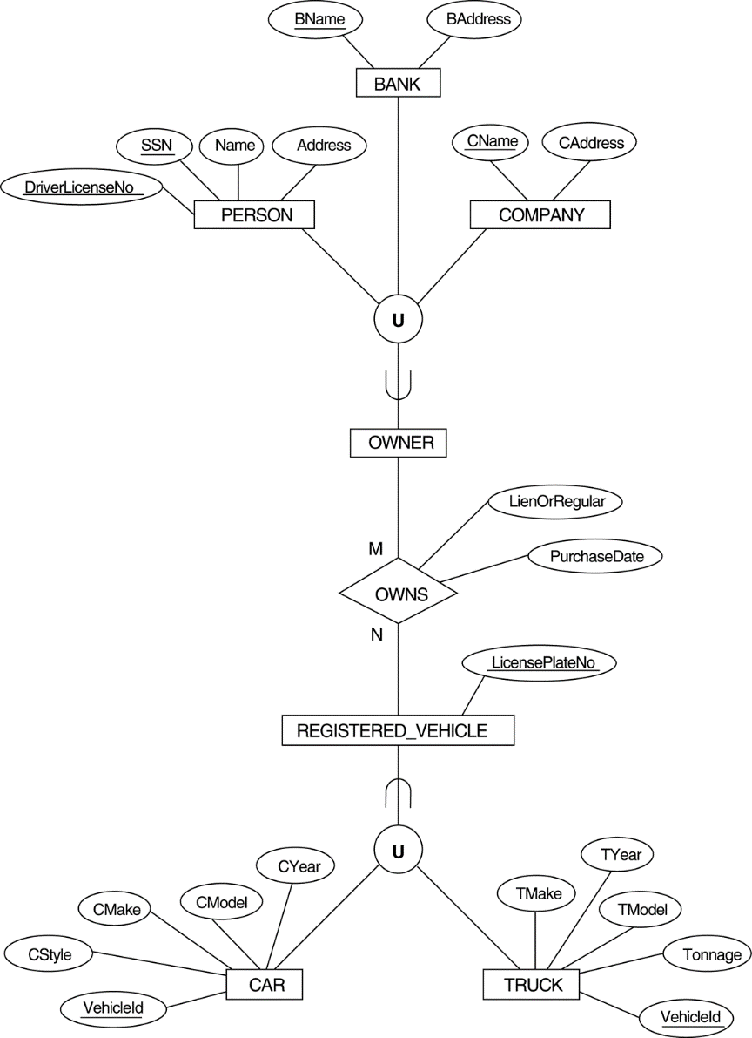
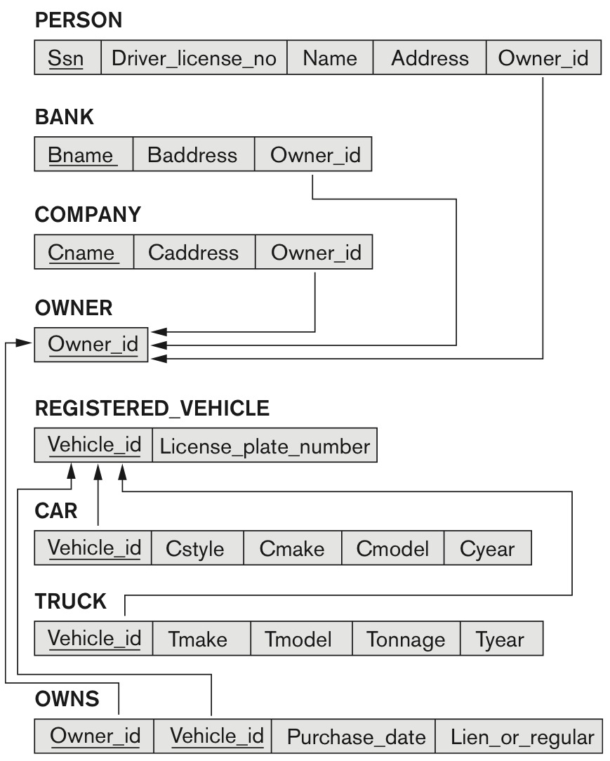
Mapping EER Union Types
Step 9: Mapping of Union Types (Categories).
For mapping a category whose defining superclass have different keys, it is customary to specify a new key attribute, called a surrogate key, when creating a relation to correspond to the category.
We can create a relation OWNER to correspond to the OWNER category and include any attributes of the category in this relation. The PKof the OWNER relation is the surrogate key, which we called OwnerId.

